Slide 1

Introduction to SQL
SQL (Structured Query Language) is a standard programming language used to manage and manipulate relational databases. It allows users to:
Retrieve data from databases using SELECT queries.
Insert, update, and delete data with INSERT, UPDATE, DELETE.
Organize data using filtering, sorting, grouping, and aggregate functions.
Analyze data with functions like SUM, COUNT, AVG and clauses like GROUP BY and WITH ROLLUP.
Create reports and summaries for business insights.
SQL is widely used in data analytics, business intelligence, and backend development, making it a key skill for managing and analyzing data efficiently.

Slide 2
SQL PROJECT .1
PROBLEM .1
Top 5 Brand–Category Combinations by Order Count
Top 5 Brand + Category combinations that appear most frequently in the product table.
PROBLEM .2
Total Revenue by Brand and Category
This query calculates and lists the total revenue for each Brand and Category, ordered from highest to lowest.
PROBLEM .3
Brand-wise Sales Summary with Grand Total
This query shows the total number of products, total price, and average price for each brand, including a grand total at the end.
PROBLEM .4
Brand-wise Product Count for Jackets and Shoes
This query shows the total number of products for each brand in the JACKET and SHOES categories.

Slide 3
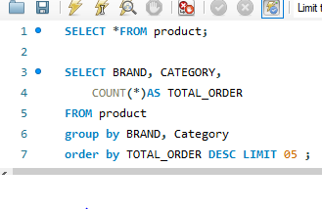
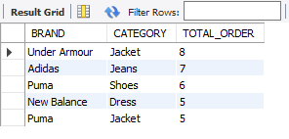
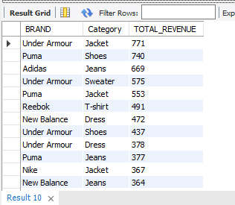
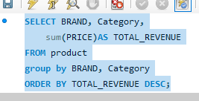
Top 5 Brand–Category Combinations by Order Count
Top 5 Brand + Category combinations that appear most frequently in the product table.
Total Revenue by Brand and Category
This query calculates and lists the total revenue for each Brand and Category, ordered from highest to lowest.
.

Slide 4
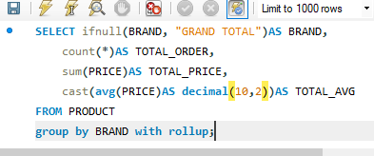
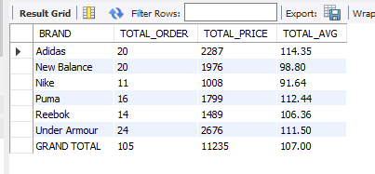
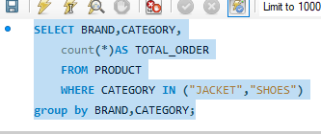
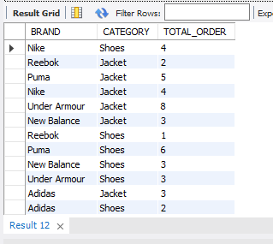
Brand-wise Sales Summary with Grand Total
This query shows the total number of products, total price, and average price for each brand, including a grand total at the end.
Brand-wise Product Count for Jackets and Shoes
This query shows the total number of products for each brand in the JACKET and SHOES categories.

Slide 5
SQL PROJECT .2
PROBLEM .1
Item-wise Maximum Price per Unit
This query shows the highest price per unit for each item from the café data.
PROBLEM .2
Item-wise Total Revenue
Shows total sales revenue for each item
PROBLEM .3
Top Selling Item (Most Orders)
Identifies the most ordered item in the café
PROBLEM .4
Overall Cafe Summary
Provides overall sales and order performance of the café

Slide 6
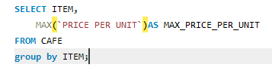
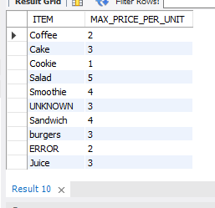
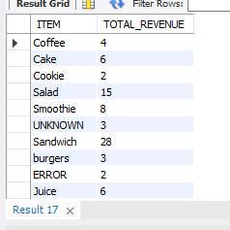

Item-wise Maximum Price per Unit
This query shows the highest price per unit for each item from the café data.
Item-wise Total Revenue
Shows total sales revenue for each item
.

Slide 7
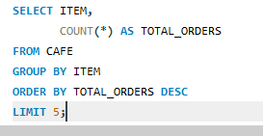
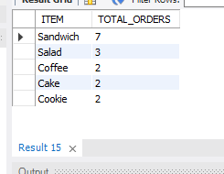
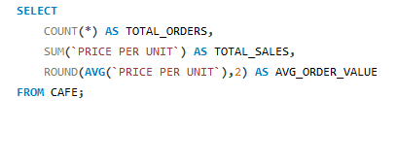

Top Selling Item (Most Orders)
Identifies the most ordered item in the café
Overall Cafe Summary
Provides overall sales and order performance of the café

